Slide 1
Big Data - Streaming
Streaming 101

Slide 2
Why Steaming?
Streaming data processing is a big deal in big data these days, and for good reasons;
Businesses crave ever-more timely insights into their data, and switching to streaming is a good way to achieve lower latency
The massive, unbounded datasets that are increasingly common in modern business are more easily tamed using a system designed for such never-ending volumes of data.
Processing data as they arrive spreads workloads out more evenly over time, yielding more consistent and predictable consumption of resources.

Slide 3
Terminology:
Streaming system: A type of data processing engine that is designed with infinite datasets in mind.
There are two important (and orthogonal) dimensions that define the shape of a given dataset: cardinality and constitution .

Slide 4
Cardinality
The cardinality of a dataset dictates its size, with the most salient aspect of cardinality being whether a given dataset is finite or infinite.
Bounded data: A type of dataset that is finite in size.
Unbounded data: A type of dataset that is infinite in size (at least theoretically).
Cardinality is important because the unbounded nature of infinite datasets imposes additional burdens on data processing frameworks that consume them.

Slide 5
Constitution
The constitution of a dataset, on the other hand, dictates its physical manifestation. As a result, the constitution defines the ways one can interact with the data in question.
There are two primary constitutions of importance:
Table: A holistic view of a dataset at a specific point in time. SQL systems have traditionally dealt in tables.
Stream: An element-by-element view of the evolution of a dataset over time. The MapReduce lineage of data processing systems have traditionally dealt in streams.
Notes:
quiz

Slide 6
The Lambda Architecture
The basic idea is that you run a streaming system alongside a batch system, both performing essentially the same calculation. The streaming system gives you low-latency, inaccurate results (either because of the use of an approximation algorithm, or because the streaming system itself does not provide correctness), and some time later a batch system rolls along and provides you with correct output. (only needed because initial streaming systems couldn’t give both)
Unfortunately, maintaining a Lambda system is a hassle: you need to build, provision, and maintain two independent versions of your pipeline and then also somehow merge the results from the two pipelines at the end.

Slide 7
Event Time vs. Processing Time
Within any data processing system, there are typically two domains of time that we care about:
Event time: This is the time at which events actually occurred.
Processing time: This is the time at which events are observed in the system.
Not all use cases care about event times, but many do. Examples include characterizing user behavior over time, most billing applications, and many types of anomaly detection, to name a few. In an ideal world, event time and processing time would always be equal, with events being processed immediately as they occur. Reality is not so kind, however, and the skew between event time and processing time is not only nonzero, but often a highly variable.

Slide 8
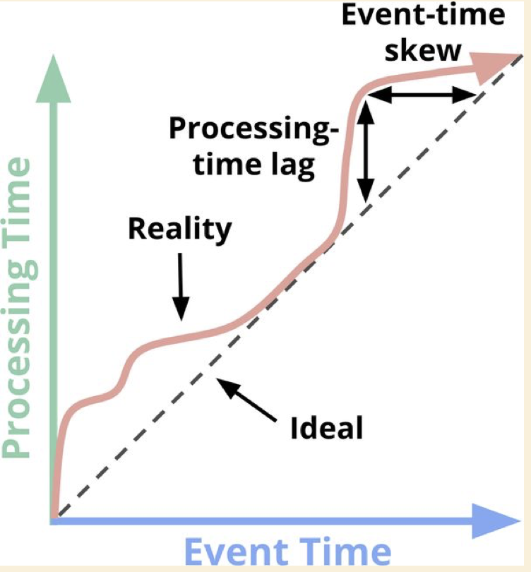
Event Time vs. Processing Time
The x-axis represents event-time completeness in the system; that is, the time X in event time up to which all data with event times less than X have been observed. The y-axis represents the progress of processing time; that is, normal clock time as observed by the data processing system as it executes.

Slide 9
Event Time vs. Processing Time
At first glance, there are two types of skew visible in this diagram, each in different time domains:
Processing time: The vertical distance between the ideal and the red line is the lag in the processing-time domain. That distance tells you how much delay is observed (in processing time) between when the events for a given time occurred and when they were processed. This is the perhaps the more natural and intuitive of the two skews.
Event Time: The horizontal distance between the ideal and the red line is the amount of event-time skew in the pipeline at that moment. It tells you how far behind the ideal (in event time) the pipeline is currently.

Slide 10
Data Processing Patterns
We will now look at the core types of usage patterns common across bounded and unbounded data processing today.
We will look at both types of processing and, where relevant, within the context of the two main types of engines we care about:
Batch
Streaming - lumping microbatch in with streaming because the differences between the two aren’t terribly important.

Slide 11
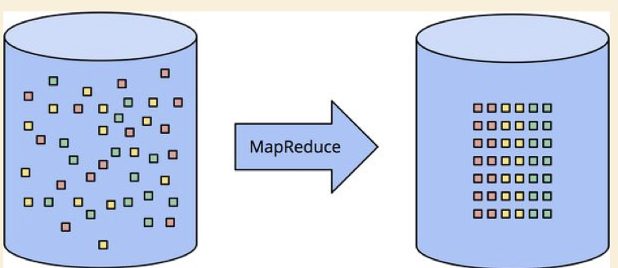
Bounded Data
Bounded data processing with a classic batch engine. A finite pool of unstructured data on the left is run through a data processing engine, resulting in corresponding structured data on the right.

Slide 12
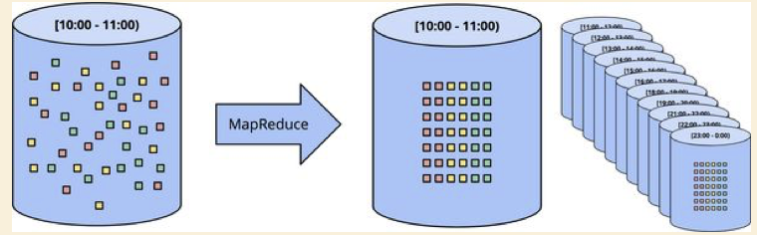
Unbounded Data: Batch - Fixed Windows
Unbounded data processing via ad hoc fixed windows with a classic batch engine. An unbounded dataset is collected up front into finite, fixed-size windows of bounded data that are then processed via successive runs a of classic batch engine.

Slide 13
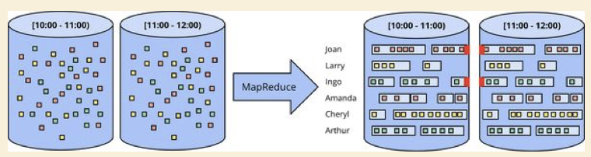
Unbounded Data: Batch - Sessions
Unbounded data processing into sessions via ad hoc fixed windows with a classic batch engine. An unbounded dataset is collected up front into finite, fixed-size windows of bounded data that are then subdivided into dynamic session windows via successive runs a of classic batch engine.

Slide 14
Unbounded Data: Streaming
Contrary to the ad hoc nature of most batch-based unbounded data processing approaches, streaming systems are built for unbounded data. As we learned earlier, for many real-world, distributed input sources, you not only find yourself dealing with unbounded data, but also data such as the following:
Highly unordered with respect to event times, meaning that you need some sort of time-based shuffle in your pipeline if you want to analyze the data in the context in which they occurred.
Of varying event-time skew, meaning that you can’t just assume you’ll always see most of the data for a given event time X within some constant epsilon of time Y .

Slide 15
Unbounded Data: Streaming
There are a handful of approaches that you can take when dealing with data that have these characteristics.
You can categorize these approaches into four groups:
Time-agnostic
Approximation
Windowing by processing time
Windowing by event time.

Slide 16
Time Agnostic
Time-agnostic processing is used for cases in which time is essentially irrelevant; that is, all relevant logic is data driven. Because everything about such use cases is dictated by the arrival of more data, there’s really nothing special a streaming engine has to support other than basic data delivery.

Slide 17
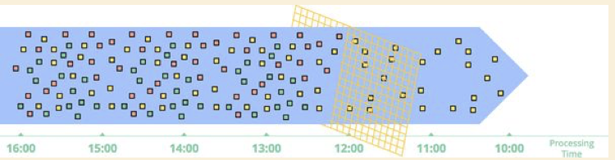
Time Agnostic : Filtering
Filtering unbounded data. A collection of data (flowing left to right) of varying types is filtered into a homogeneous collection containing a single type.

Slide 18
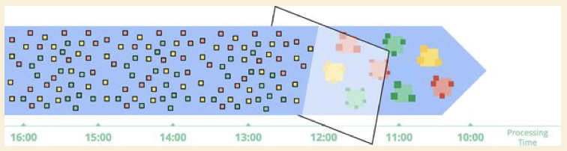
Approximation
The second major category of approaches is approximation algorithms, such as approximate Top-N , streaming k-means , and so on.
Computing approximations on unbounded data. Data are run through a complex algorithm, yielding output data that look more or less like the desired result on the other side.

Slide 19
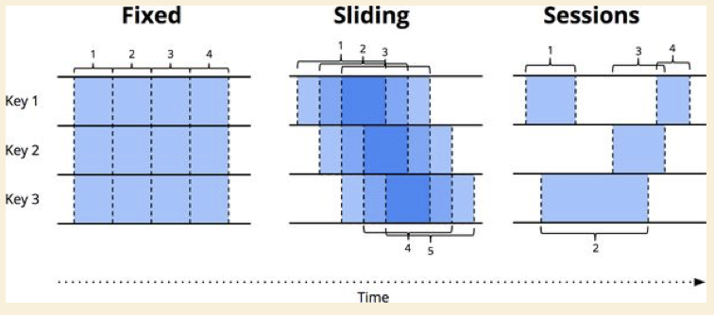
Windowing
Windowing is simply the notion of taking a data source (either unbounded or bounded), and chopping it up along temporal boundaries into finite chunks for processing.

Slide 20
Windowing: Fixed Windows (aka tumbling windows)
Fixed windows slice time into segments with a fixed-size temporal length. Typically the segments for fixed windows are applied uniformly across the entire dataset, which is an example of aligned windows. In some cases, it’s desirable to phase-shift the windows for different subsets of the data (e.g., per key) to spread window completion load more evenly over time, which instead is an example of unaligned windows because they vary across the data.

Slide 21
Windowing: Sliding Windows (aka hopping windows)
A generalization of fixed windows, sliding windows are defined by a fixed length and a fixed period. If the period is less than the length, the windows overlap. If the period equals the length, you have fixed windows. And if the period is greater than the length, you have a weird sort of sampling window that looks only at subsets of the data over time. As with fixed windows, sliding windows are typically aligned, though they can be unaligned as a performance optimization in certain use cases.

Slide 22
Windowing: Sessions
Sessions are commonly used for analyzing user behavior over time, by grouping together a series of temporally related events (e.g., a sequence of videos viewed in one sitting). Sessions are interesting because their lengths cannot be defined a priori; they are dependent upon the actual data involved. They’re also the canonical example of unaligned windows because sessions are practically never identical across different subsets of data (e.g., different users).

Slide 23
Windowing by
Processing Time

Slide 24
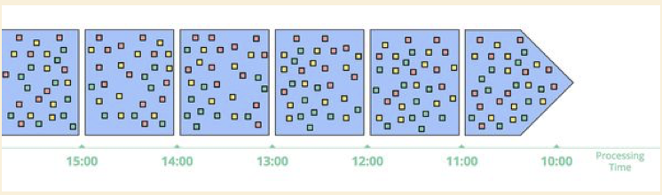
Windowing: Fixed Windows
Windowing into fixed windows by processing time. Data are collected into windows based on the order they arrive in the pipeline.

Slide 25
Windowing by
Event Time

Slide 26
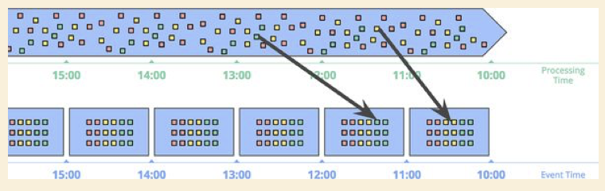
Windowing: Fixed Windows : Event Time
Windowing into fixed windows by event time. Data are collected into windows based on the times at which they occurred. The black arrows call out example data that arrived in processing-time windows that differed from the event-time windows to which they belonged.

Slide 27
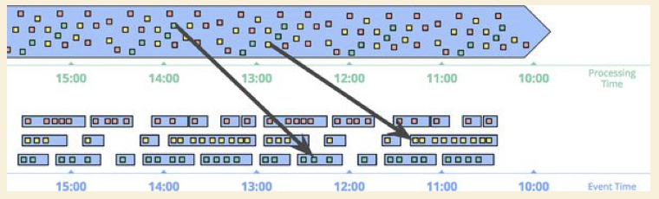
Windowing: Sessions - Event Time
Windowing into session windows by event time. Data are collected into session windows capturing bursts of activity based on the times that the corresponding events occurred. The black arrows again call out the temporal shuffle necessary to put the data into their correct event-time locations.

Slide 28
Event Time Drawbacks
Of course, powerful semantics rarely come for free, and event-time windows are no exception. Event-time windows have two notable drawbacks due to the fact that windows must often live longer (in processing time) than the actual length of the window itself:
Buffering
Completeness

Slide 29
Event Time Drawbacks : Buffering
Buffering:
Due to extended window lifetimes, more buffering of data is required. Thankfully, persistent storage is generally the cheapest of the resource types most data processing systems depend on (the others being primarily CPU, network bandwidth, and RAM). As such, this problem is typically much less of a concern than you might think when using any well-designed data processing system with strongly consistent persistent state and a decent in-memory caching layer. Also, many useful aggregations do not require the entire input set to be buffered (e.g., sum or average), but instead can be performed incrementally, with a much smaller, intermediate aggregate stored in persistent state.

Slide 30
Event Time Drawbacks : Completeness
Completeness:
Given that we often have no good way of knowing when we’ve seen all of the data for a given window, how do we know when the results for the window are ready to materialize? In truth, we simply don’t. For many types of inputs, the system can give a reasonably accurate heuristic estimate of window completion via something like the watermarks found in MillWheel, Cloud Dataflow, and Flink . But for cases in which absolute correctness is paramount (again, think billing), the only real option is to provide a way for the pipeline builder to express when they want results for windows to be materialized and how those results should be refined over time.

